Slide 1

Project Politics
By Iyaad Mohamed Arshad

Slide 2
Objective
To compare rights of citizens in different countries
To compare the political systems of different countries

Slide 3
Countries to compare
Russia
America
India
Sri Lanka

Slide 4

America

Slide 5
US population rights
Freedom of religion
Right to own and carry guns
Prevent the armed forces from being housed or fed.
Protection from unlawful or unwarranted search
Protection for being tried twice for the same crime
Right to a trial in the federal civil cases.
Unusual punishments or excessive bail or fines on people.

Slide 6
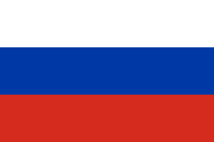
Russia

Slide 7
Russian Population rights
Right to equality
Right to life
Right to personal dignity.
Personal Freedom
Freedom of movement
Freedom of religion
Right to a home
Right to healthcare

Slide 8
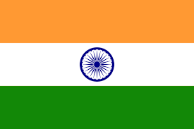
India

Slide 9
India Population rights
Right to equality (Article 14–18)
Right to freedom (Article 19–22)
Right against exploitation (Article 23–24)
Right to freedom of religion (Article 25–28)
Cultural and educational rights (Article 29–30)
Right to constitutional remedies (Article 32)

Slide 10

Sri Lanka

Slide 11
Sri Lanka Human Rights
Freedom of expression, association and assembly.
Right to truth, justice and reparation.
Arbitrary arrests and detentions.
Excessive use of force and extrajudicial executions.
Discrimination.
Gender-based discrimination and violence.
Right to health.

